Slide 1
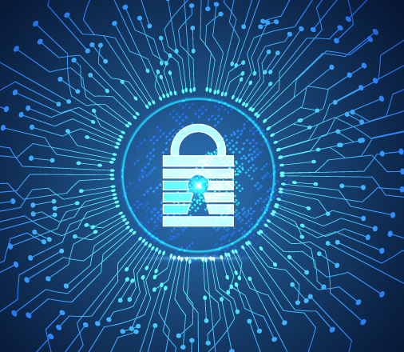

V Semester CSF
IT Data Security Lecture Series
Dr. Narendra Kumar Dewangan
Assistant Professor, Senior Scale
Systems, School of Computer Sciences
UPES Dehradun
Lecture-6

Slide 2
Cryptography-based Threats
Databases and Banking Threats

Slide 3
Database Security
Database security includes a variety of measures used to secure database management systems from malicious cyber-attacks and illegitimate use. Database security programs are designed to protect not only the data within the database, but also the data management system itself, and every application that accesses it, from misuse, damage, and intrusion.

Slide 4
Insider Threats
An insider threat is a security risk from one of the following three sources, each of which has privileged means of entry to the database:
A malicious insider with ill-intent
A negligent person within the organization who exposes the database to attack through careless actions
An outsider who obtains credentials through social engineering or other methods, or gains access to the database’s credentials
An insider threat is one of the most typical causes of database security breaches and it often occurs because a lot of employees have been granted privileged user access.

Slide 5
Human Error
Weak passwords, password sharing, accidental erasure or corruption of data, and other undesirable user behaviors are still the cause of almost half of data breaches reported.

Slide 6
Exploitation of Database Software Vulnerabilities
Attackers constantly attempt to isolate and target vulnerabilities in software, and database management software is a highly valuable target. New vulnerabilities are discovered daily, and all open source database management platforms and commercial database software vendors issue security patches regularly. However, if you don’t use these patches quickly, your database might be exposed to attack.
Even if you do apply patches on time, there is always the risk of zero-day attacks, when attackers discover a vulnerability, but it has not yet been discovered and patched by the database vendor.

Slide 7
SQL/NoSQL Injection Attacks
A database-specific threat involves the use of arbitrary non-SQL and SQL attack strings into database queries. Typically, these are queries created as an extension of web application forms, or received via HTTP requests. Any database system is vulnerable to these attacks, if developers do not adhere to secure coding practices, and if the organization does not carry out regular vulnerability testing.

Slide 8
Buffer Overflow Attacks
Buffer overflow takes place when a process tries to write a large amount of data to a fixed-length block of memory, more than it is permitted to hold. Attackers might use the excess data, kept in adjacent memory addresses, as the starting point from which to launch attacks.

Slide 9
Denial of Service (DoS/DDoS) Attacks
In a denial of service (DoS) attack, the cybercriminal overwhelms the target service—in this instance the database server—using a large amount of fake requests. The result is that the server cannot carry out genuine requests from actual users, and often crashes or becomes unstable.
In a distributed denial of service attack (DDoS), fake traffic is generated by a large number of computers, participating in a botnet controlled by the attacker. This generates very large traffic volumes, which are difficult to stop without a highly scalable defensive architecture. Cloud-based DDoS protection services can scale up dynamically to address very large DDoS attacks.

Slide 10
Banking Threats
The banking industry has prioritized cybersecurity highly. Building credibility and trust is the cornerstone of banking, so it becomes much more essential. Here are five factors that demonstrate the significance of cybersecurity in banking industry and why you should care:
Everyone looks to be entirely cashless and using digital payment methods like debit and credit cards. In this case, ensuring that the required cybersecurity safeguards are in place to protect your privacy and data is critical.
After data breaches, it could be difficult to trust financial institutions. That's a significant issue for banks. Data breaches caused by a shoddy cybersecurity solution may easily lead to their consumer base moving their business elsewhere.
The majority of the time, when a bank's data is compromised, you lose time and money. Recovery from the same can be unpleasant and time-consuming. It would entail canceling cards, reviewing statements, and keeping a watchful lookout for issues.
Inappropriate use of your private information might be very harmful. Your data is sensitive and could expose a lot of information that could be exploited against you, even if the cards are revoked and fraud is swiftly dealt with.
Banks need to be more cautious than most other firms. That is the price for banks to retain the kind of valuable personal data they do. If the bank's information is not safeguarded against risks from cybercrime, it could be compromised.

Slide 11
Phishing Attack
One of the most frequent problems with cyber security in banking sector is phishing assaults. They can be used to enter a financial institution's network and conduct a more severe attack like APT, which can have a disastrous effect on those organizations (Advanced Persistent Threat). In an APT, a user who is not permitted can access the system and use it while going unnoticed for a long time. Significant financial, data and reputational losses may result from this. According to the survey, phishing assaults on financial institutions peaked in the first quarter of 2021.

Slide 12
Trojans
The term "Trojan" is used to designate several dangerous tactics hackers use to cheat their way into secure data. Until it is installed on a computer, a Banker Trojan looks like trustworthy software. However, it is a malicious computer application created to access private data processed or kept by online banking systems. This kind of computer program has a backdoor that enables access to a computer from the outside.
Around the globe, there were roughly 54,000 installation packages for mobile banking trojans in the first quarter of 2022. There has been an increase of more than 53% compared to last year's quarter. After declining for the first three quarters of 2021, the number of trojan packages targeting mobile banking increased in the fourth quarter.

Slide 13
Ransomeware
A cyber threat known as ransomware encrypts important data and prevents owners from accessing it until they pay a high cost or ransom. Since 90% of banking institutions have faced ransomware in the past year, it poses a severe threat to them.
In addition to posing a threat to financial cybersecurity, ransomware also affects cryptocurrency. Due to their decentralized structure, cryptocurrencies allow fraudsters to break into trading systems and steal money.

Slide 14
Spoofing
Hackers use a clone site in this type of cyberattack. By posing as a financial website, they;
Design a layout that resembles the original one in both appearance and functionality.
Establish a domain with a modest modification in spelling or domain extension.
The user can access this duplicate website via a third-party messaging service, such as text or email. Hackers can access a user's login information when the person is not paying attention. Seamless multi-factor authentication can solve a lot of these issues.
The Reserve Bank of India (RBI) reported bank frauds of 604 billion Indian rupees in 2022. From more than 1.3 trillion rupees in 2021, this was a decline.

Slide 15
Applications of Cybersecurity in Banking
Network Security Surveillance
Software Security
Risk Management
Protecting Critical System

Slide 16
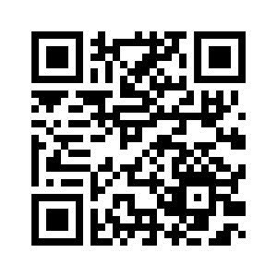
Thank You

